Slide 1

How to Have a Number One Hit the Easy Way
Analysis of the music industry using data mining techniques
Dominique McBride, Peter Fuentes Rosa, Peter Pezon, and Ben Ossyra

Slide 2
Business Case
How can A&R departments optimize financial resources and invest in songs that are likely to be successful?
Analysis
Evaluation of top charted, GRAMMY nominated and GRAMMY awarded tracks
What impact does audio and artist features have on the success of a song?
Background
KLF Case Study: "The Timelords" published a step-by-step guide to achieving a No. 1 single in a book entitled, "The Manual" released in 1988.

Slide 3
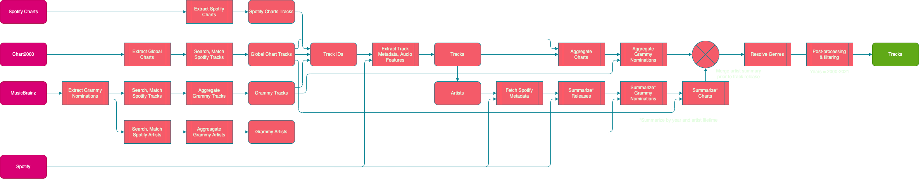
Data Collection
Data source | Data collected
Chart2000 | Global Top 50 monthly charts
MusicBrainz | Artist profile, Grammy nominations, Record labels
Spotify | Artist releases, Audio features, Top 200 daily charts
Random sampling
Spotify Track ID is the unit of account
Search on Spotify,
Fuzzy match search results
Summarize artist profile history to the track’s release date
Sum artist statistics for all artists attributed to release
Notes:
Lil Nas X is a Grammy award winner, but when Old Town Road was released in 2019, he wasn’t.

Slide 4
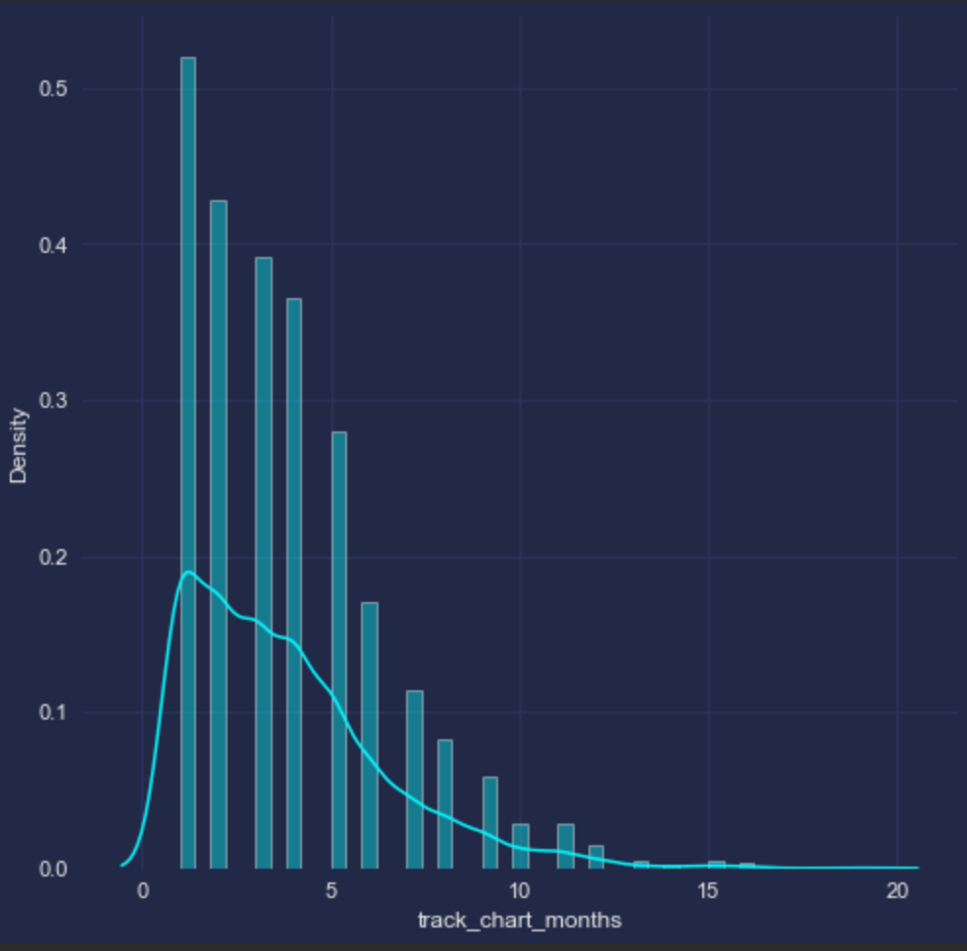
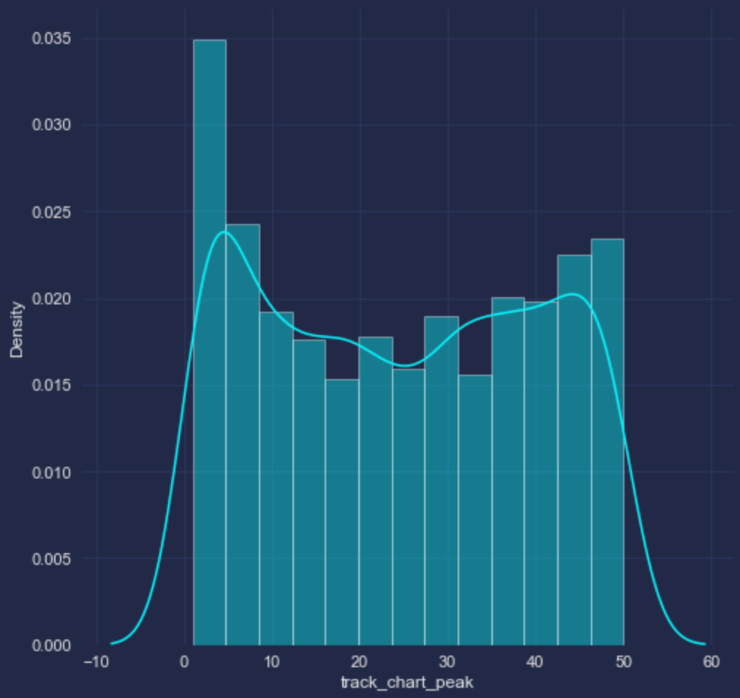
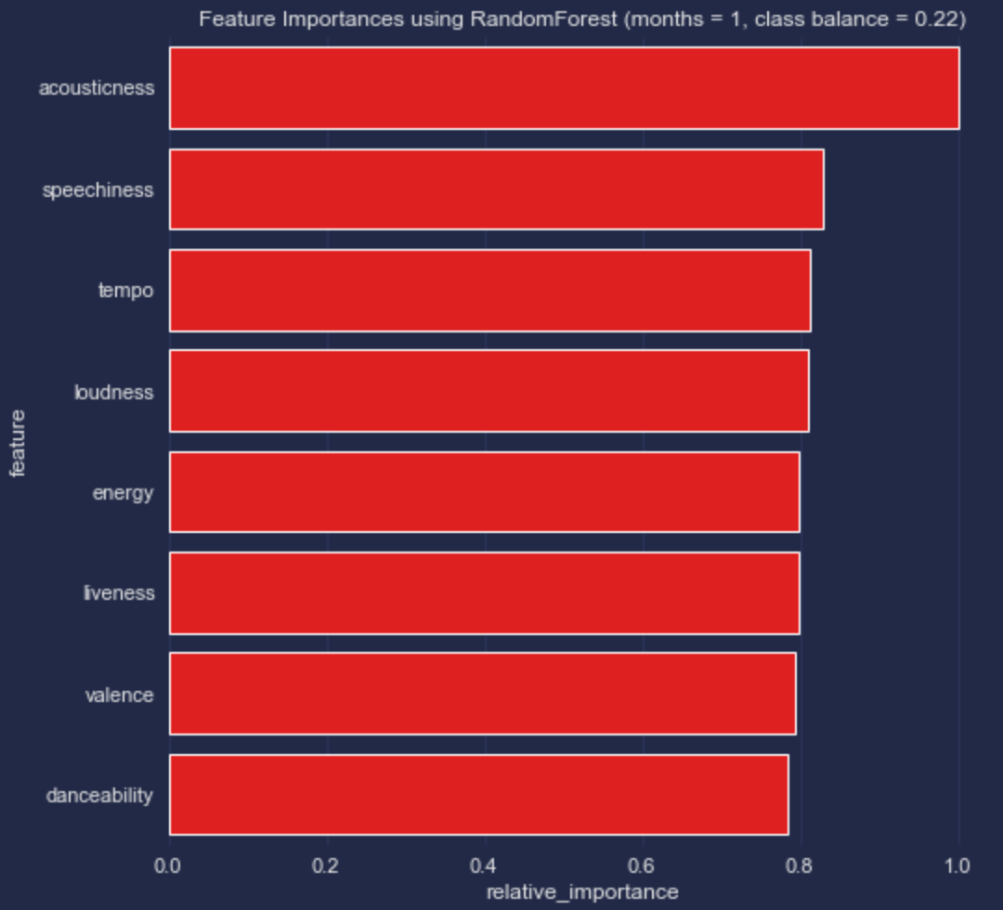
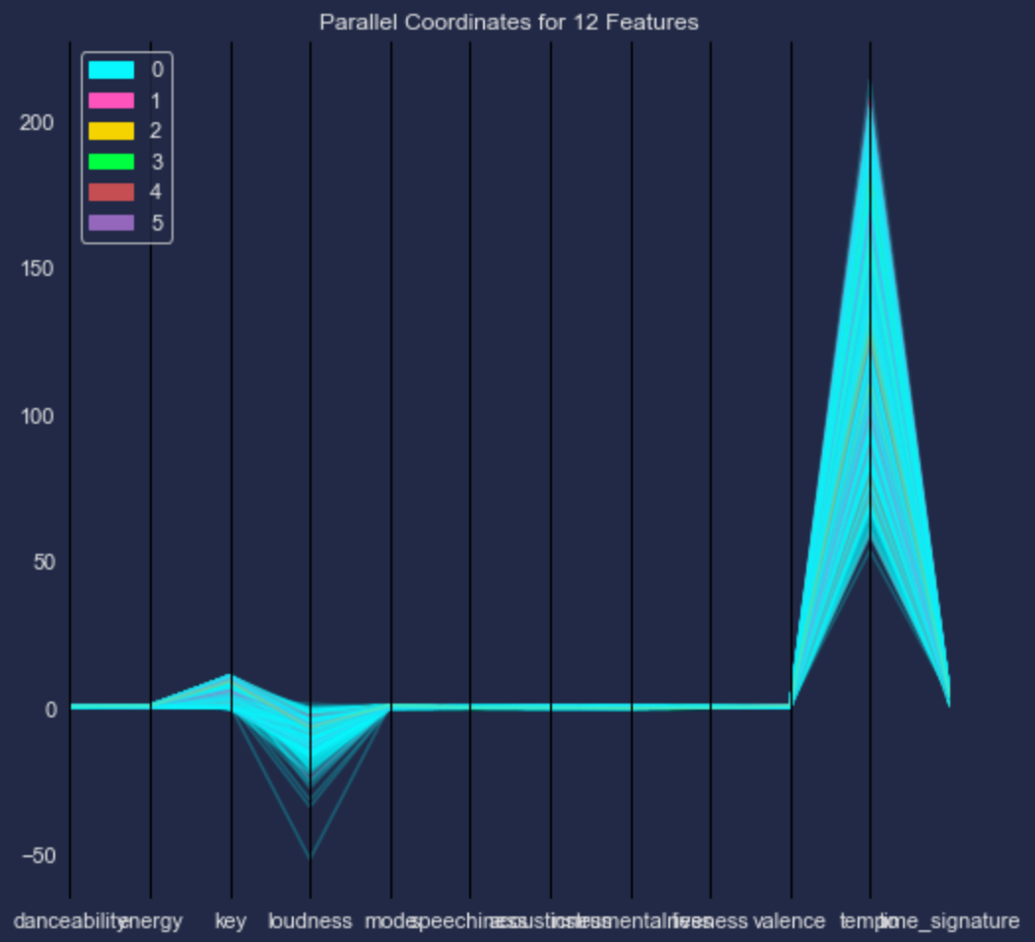
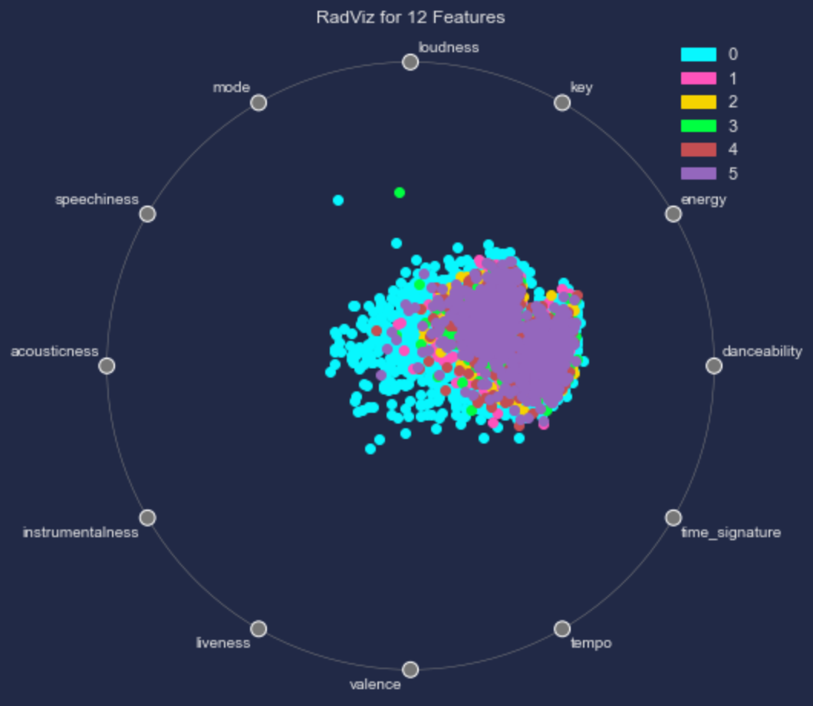
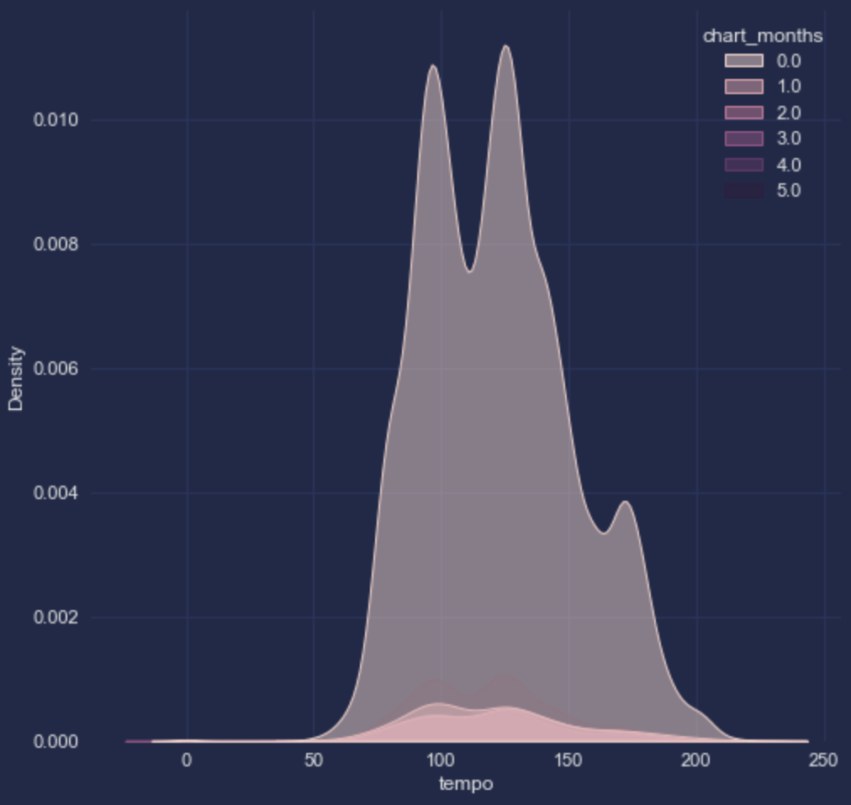
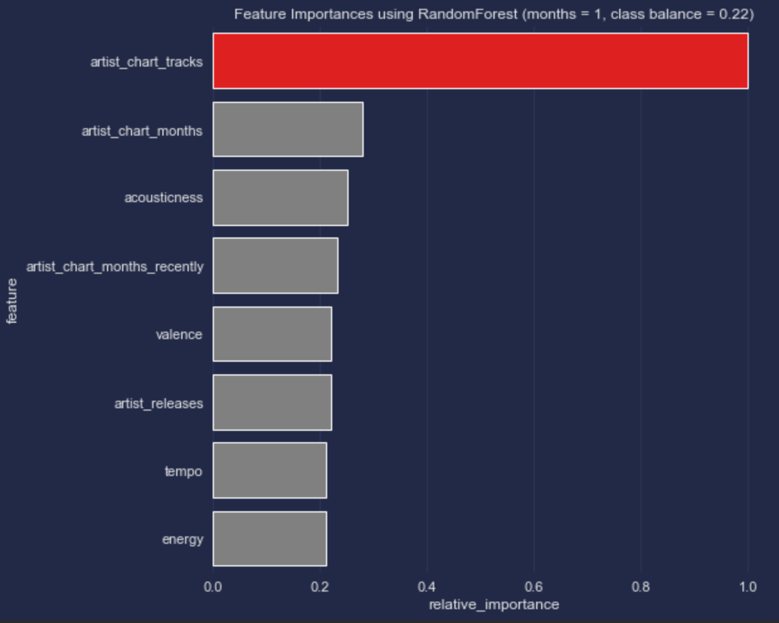
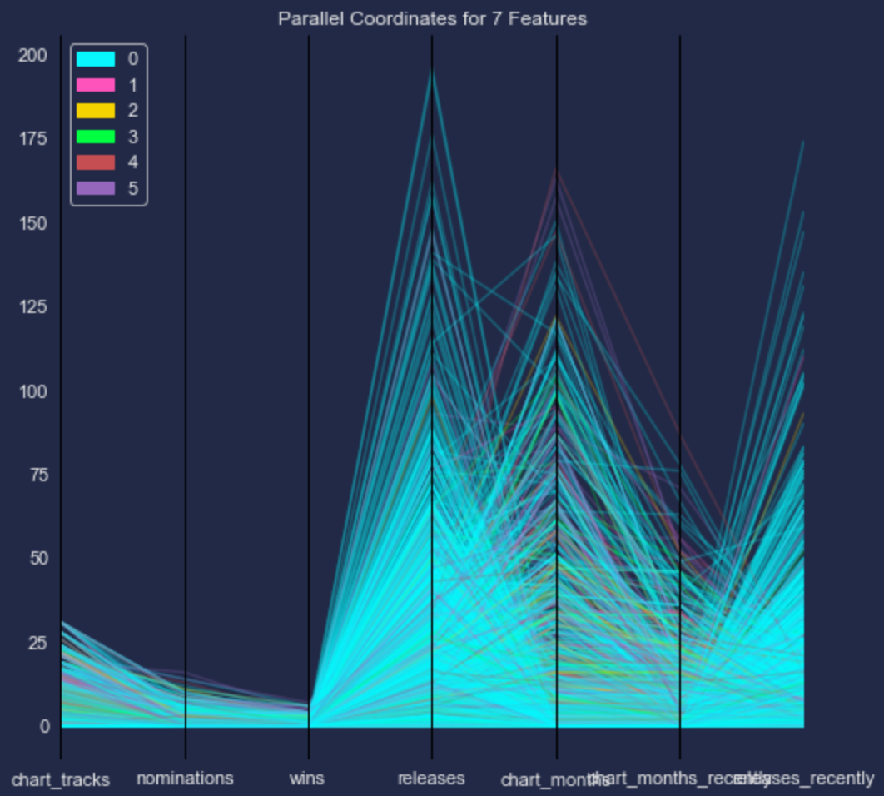
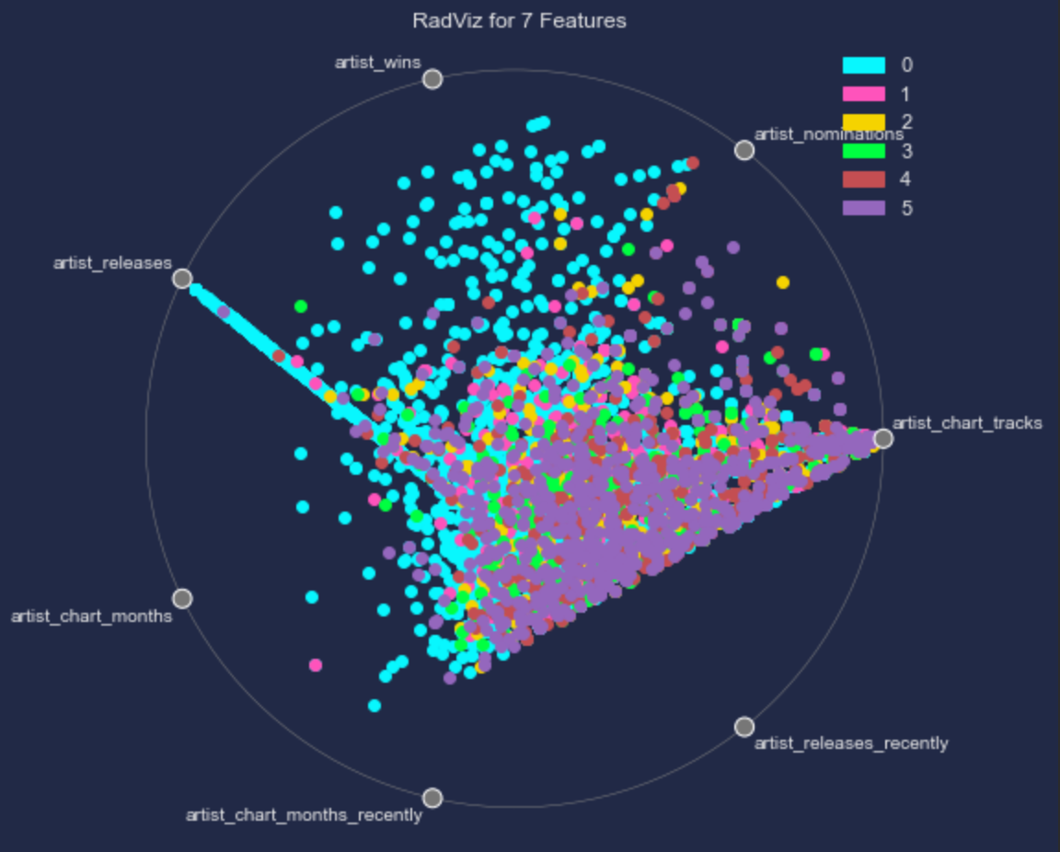


Dataset
Target variable: # Charted months
Alternative label: chart peak
14,967 tracks, 69 columns
5,814 tracks (US artist)
3,220 tracks charted $≥$1 mos. (21.5%)
2,089 tracks (US artists, 35.9%)
662 tracks charted $≥6$ mos. (4.4%)
409 tracks (US artists, 7%)
Audio features
Acousticness
Danceability
Energy
Instrumentalness
Liveness
Loudness
Key
Mode
Speechiness
Tempo
Time signature
Valence
Artist features
# Charted tracks
# Charted months
# Grammy nominations
# Grammy wins
# Releases
# Releases recently
Genres
Major label (bool, NA)
Tempo varies the most of all features; varying charting months has no impact on distribution
Feature importance of all features: audio features barely relevant compared to artist’s charting history
Notes:
Parallel coordinates and RadViz charts for artist features, top-left and bottom-left, respectively; and for audio features, top-right and bottom-right.
Feature importance of (a) all features, (b) audio features

Slide 5
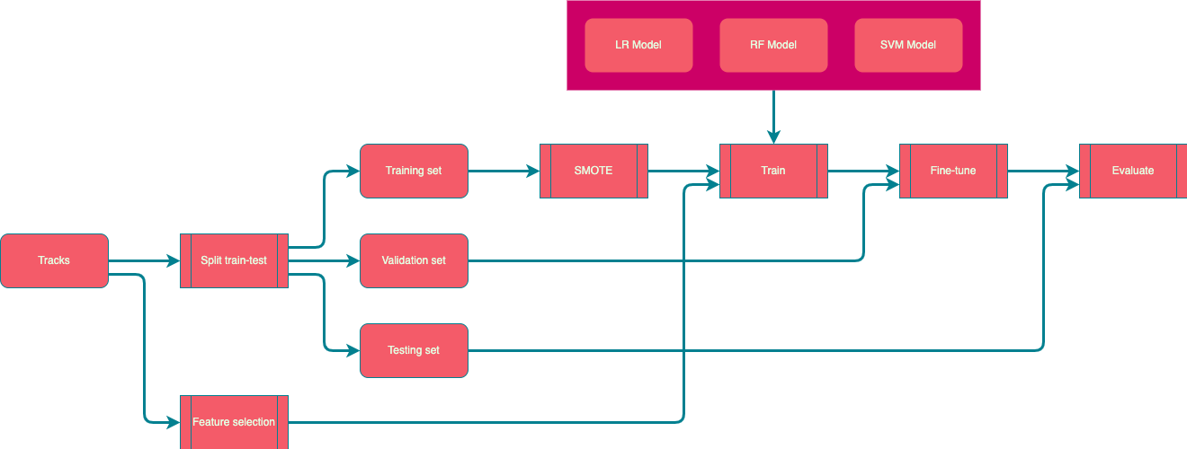
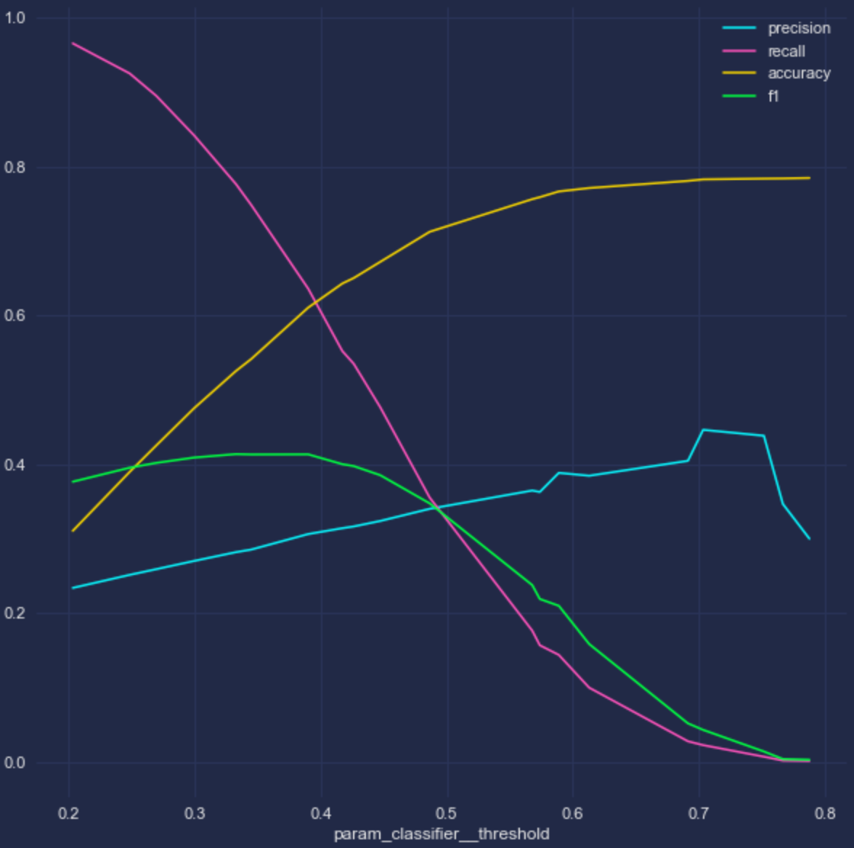
Methodology
Models: Logistic Regression, Random Forest, SVM, Perceptron
Compare data subsets, feature sets, and model families, focusing on audio features
Datasets | Global-1, Global-6, US-1, US-6
Features | Audio-All, Audio-BS, Audio-RFE, ArtistReleases, Distances
Over-sample minority
Weighted classes
Randomized Parameter search
Evaluate: Compare AUC, Precision
Pre-processing: feature scaling
Fine-tune: discriminant threshold to minimize Type I error, maximize precision.
Type I error: Artist pursued, doesn’t chart. Cost is time. Minimize Type I error to reduce wasted time.
Type II error: Missed an artist that made a hit. Cost is revenue and reputation.
Feature selection: Forward/backward selection on p-value, Recursive Feature Extraction
Notes:
Datasets:
- Global-1: Global charts, success $≥$ 1 months charted
- Global-6: Global charts, success $≥$ 6 months charted
- US-1: US charts, success $≥$ 1 months charted
- US-6: US charts, success $≥$ 6 months charted

Slide 6
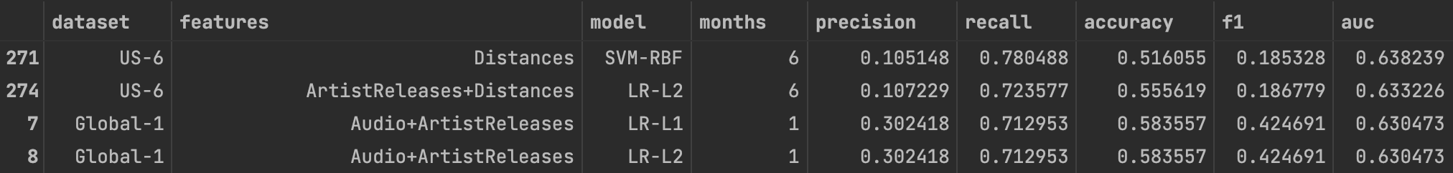
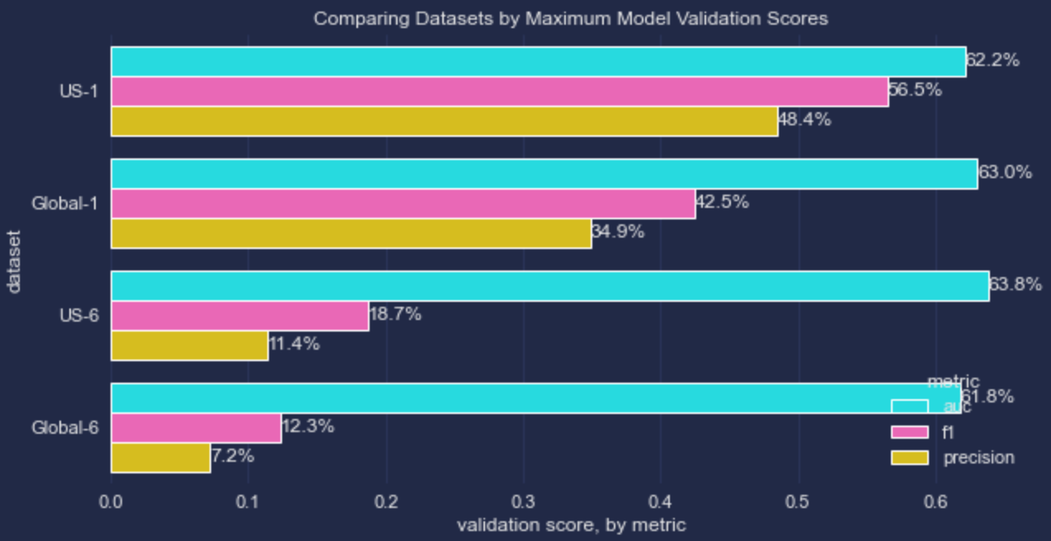
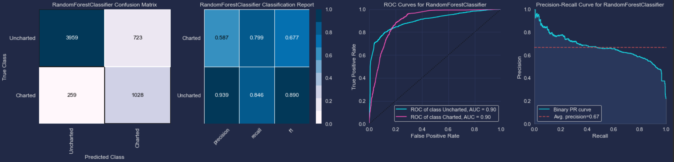
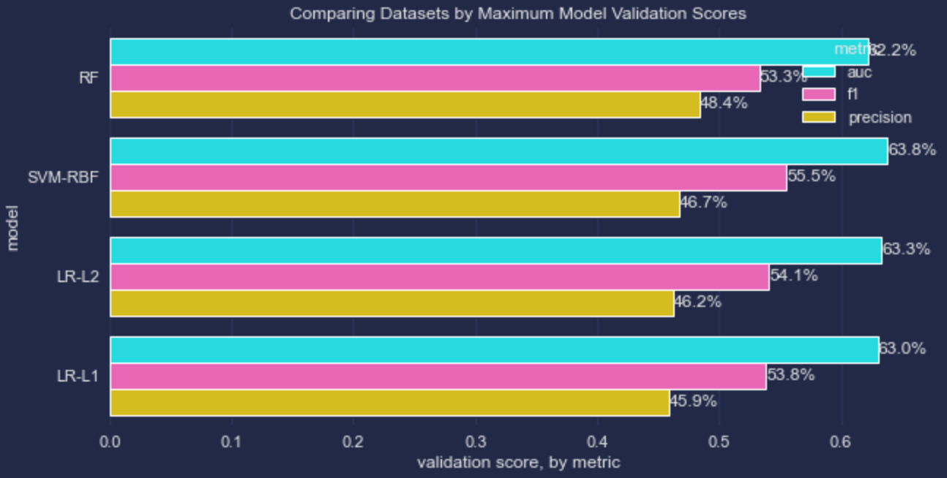
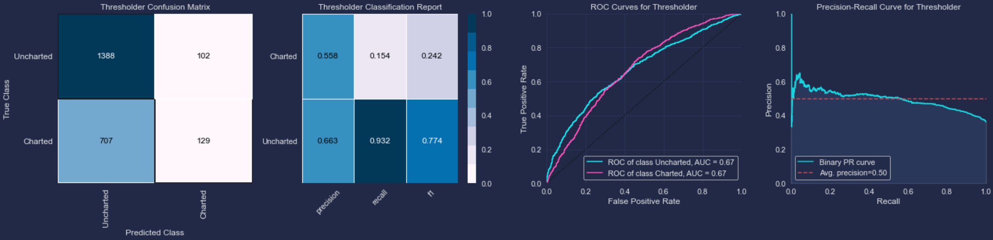
Model Results
280 models trained on different model families, sets of features; sorted by AUC
Models trained on US artists are more precise
Artist profile history is the best predictor: Best fitting model has only artist features
RF highest precision; SVM-RBF highest AUC
Fine-tuned Random Forest model on audio features and recent releases
US artists, 0.49 threshold
Notes:
Although audio feature models are at a disadvantage, they can be tuned to have precision almost as good as artist feature models.

Slide 7

Value Added Results & Next Steps
Value Added:
Business impact - Song selection result.
Minimized Type 1 – artists pursued that don’t chart, reducing wasted time.
Next steps:
Data Cleaning - Treating outliers matching content with Spotify and getting record label data.
Prediction Potential - Potential charting longevity, revenue.
Additional Data - Samples data & Additional Chart Data.
Future Updates - Train models on specific genres.

